Slide 1

Sequential Design/Active Learning For Classification Problem
Yi-Shin Gan and Pouya Ahadi

Slide 2
Classification and Sampling
T = total budget for labeling
Sequential Design / Active Learning

Slide 3
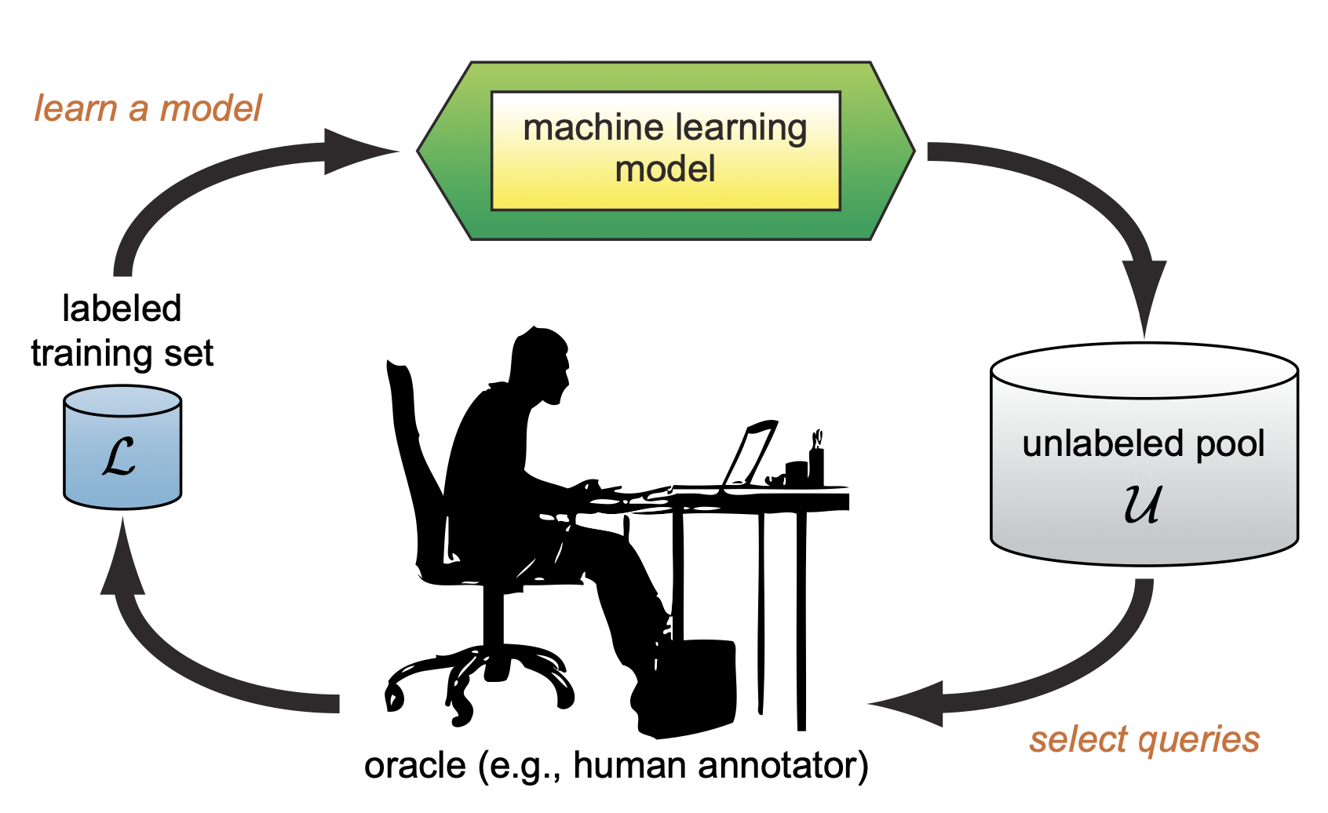
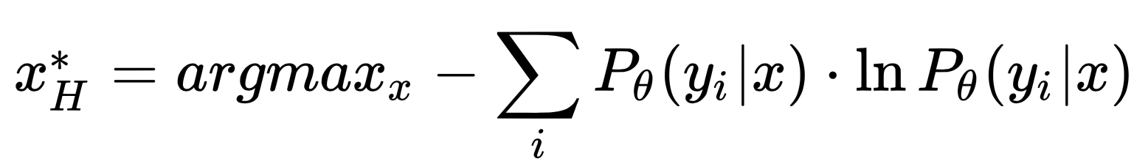
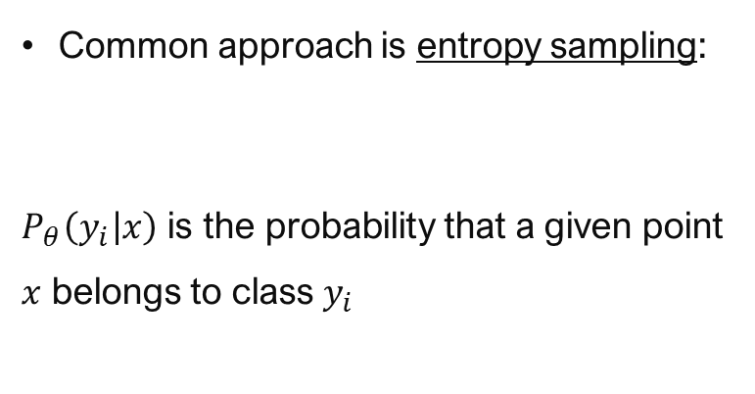
Uncertain Samples
(informative)
Active Learning (AL)
B = budget for each cycle of AL
Common approach is entropy sampling:
$P_{θ}\left(\left.y_{i}\right|x\right)$ is the probability that a given point $x$ belongs to class $y_{i}$
[source: Settles, 2009]

Slide 4
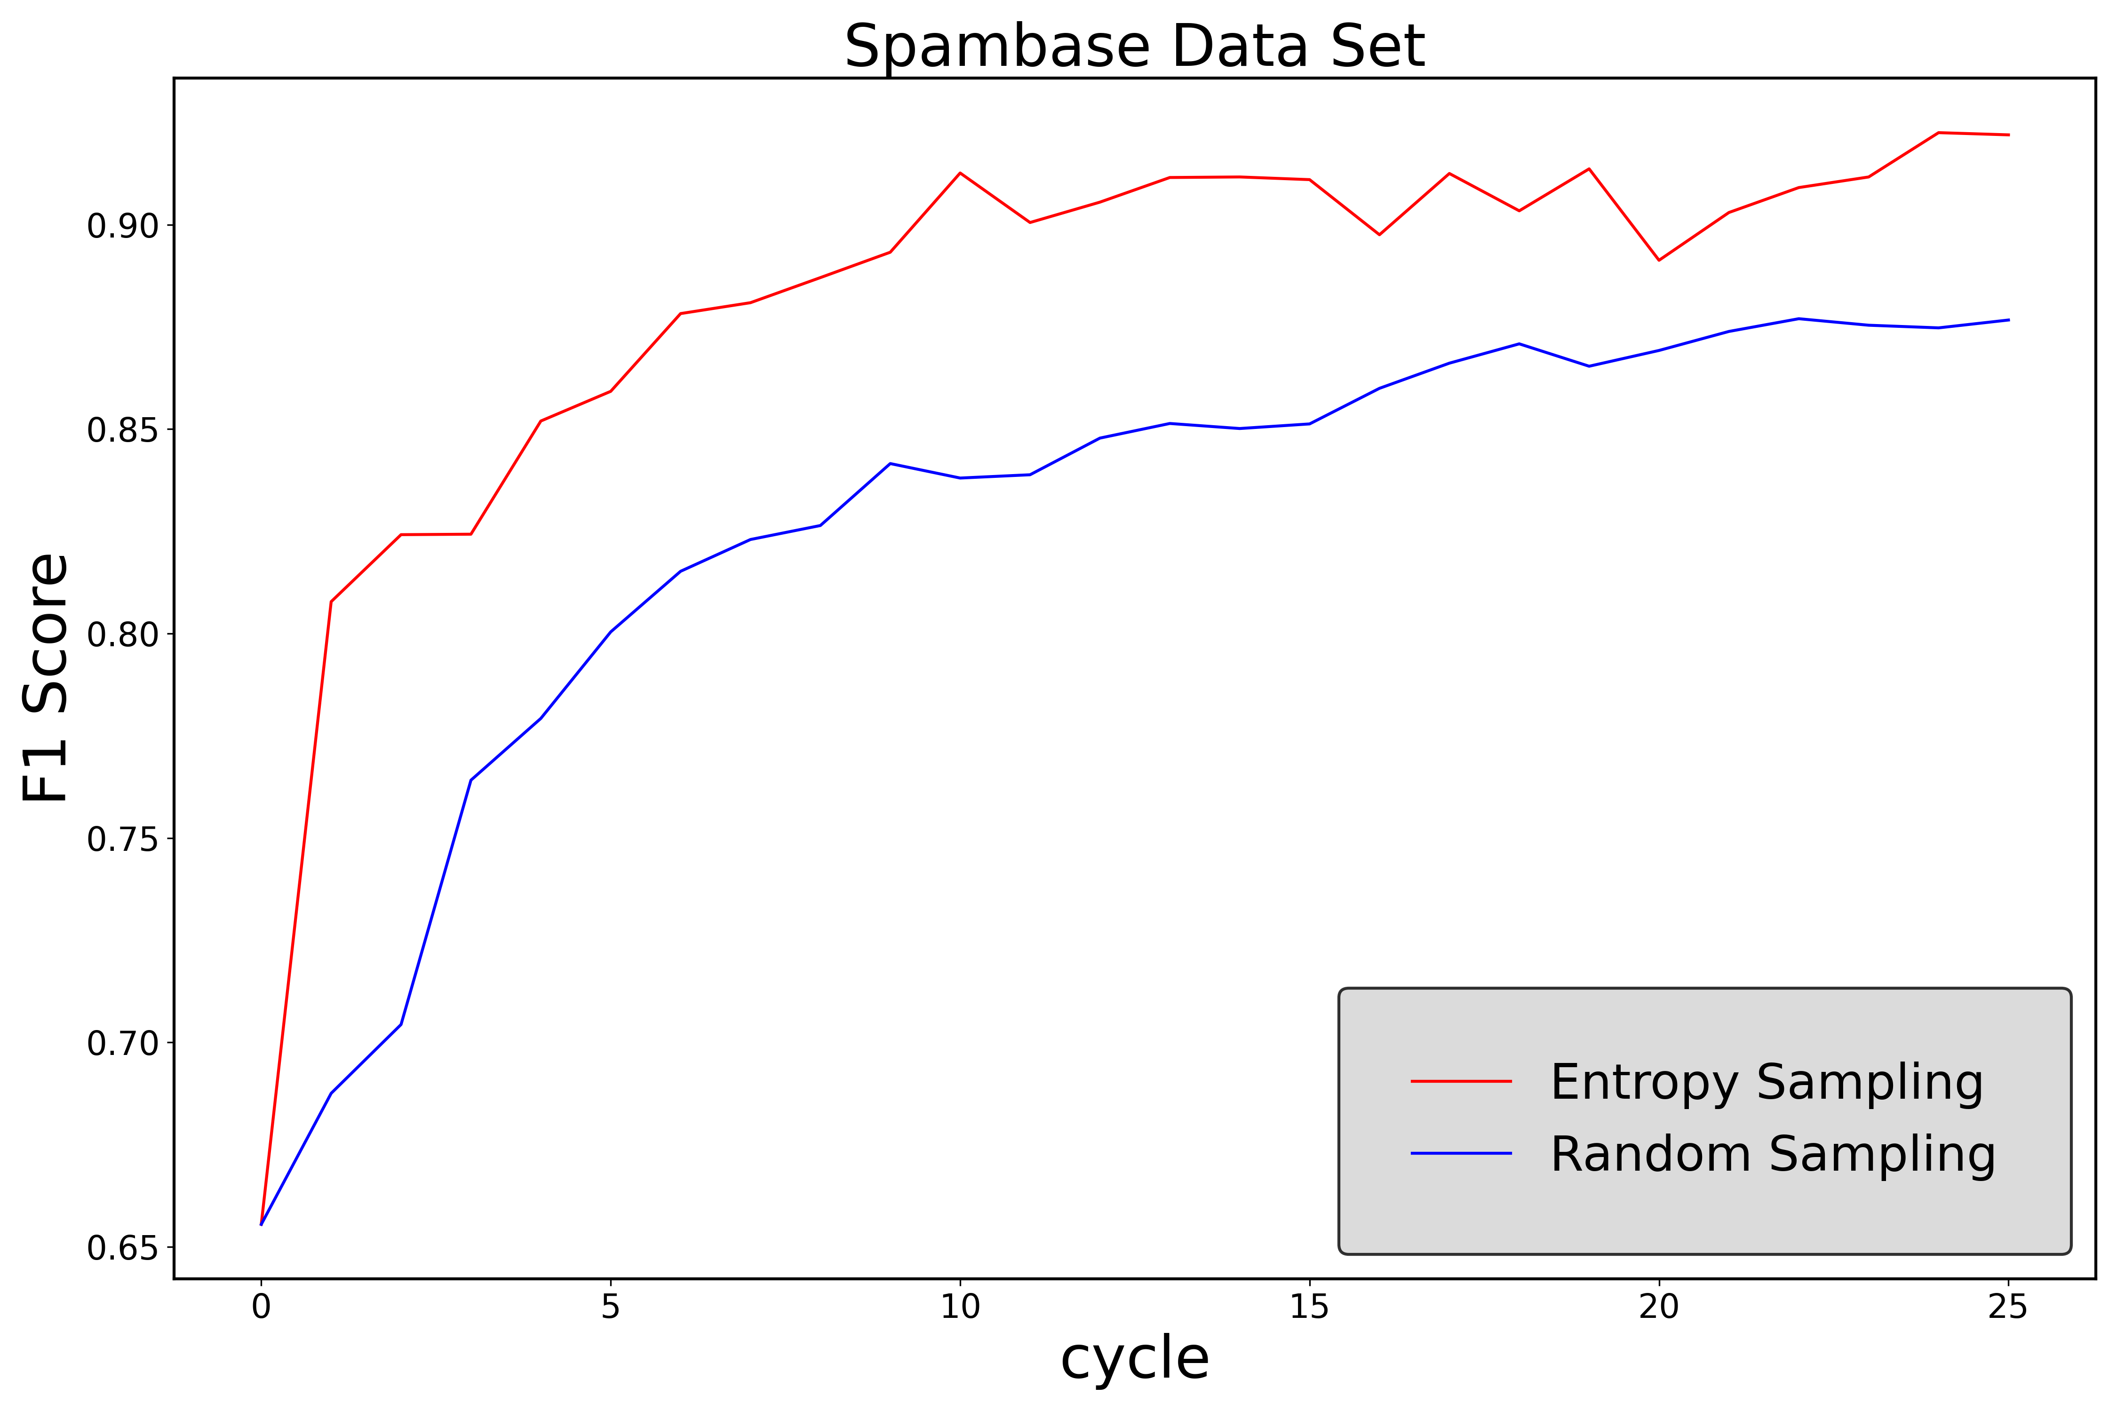
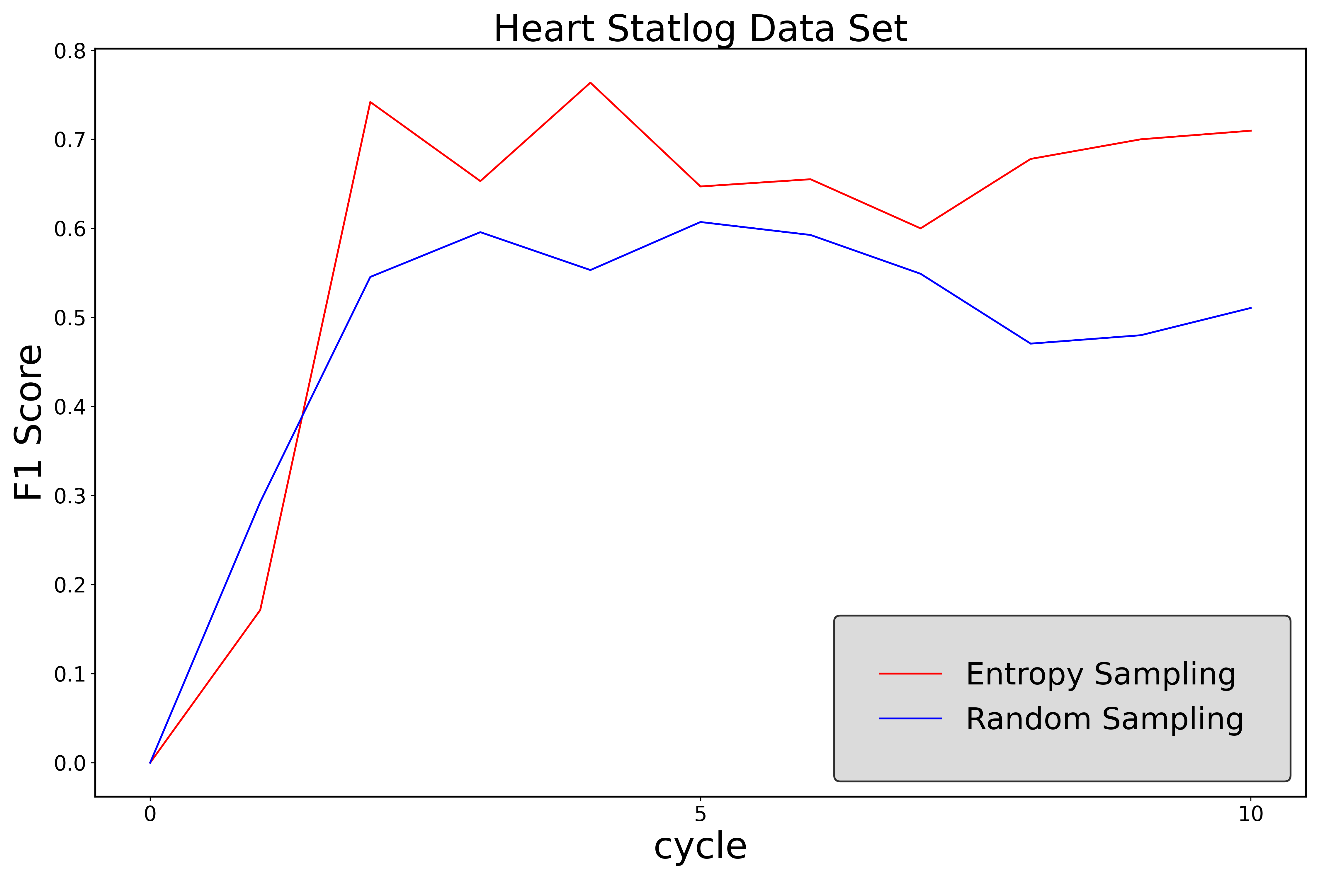
Experiments and Results
Data Set | Description | n | m | Number of Cycles | Query per Cycle
Heart Statlog | Heart disease detection | 13 | 270 | 10 | 5
Spambase | Classifying emails into spam or non-spam | 58 | 4,601 | 25 | 30

Slide 5
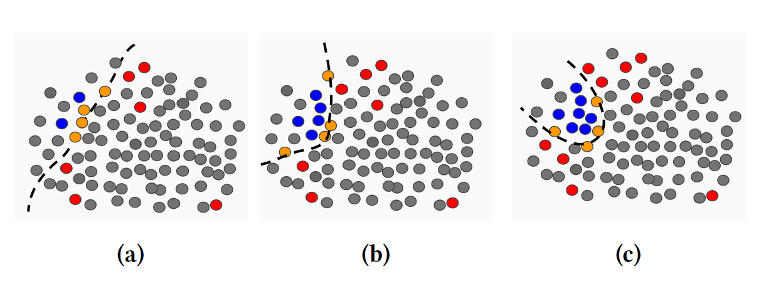
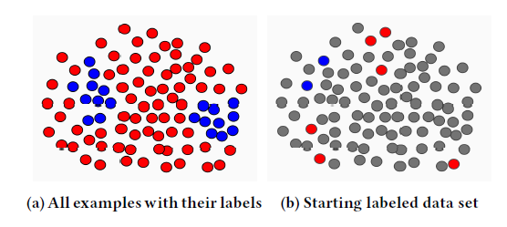

AL with Exploration
[Kazerouni et al. 2020 ] Uncertainty sampling approaches tend to exploit the existing labeled data points.
We need to add exploration: $B=B_{exploitation}+B_{exploration}$
[Source: Kazerouni et al. 2020]
Random Exploration
Gaussian exploration
Max-min distance design
Space filling design

Slide 6

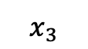
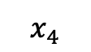
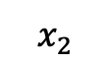


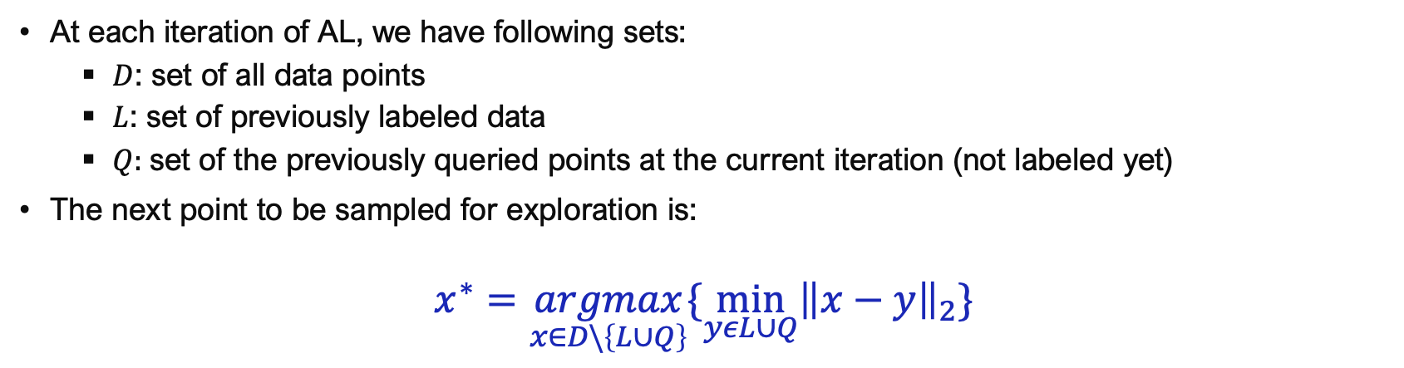

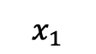

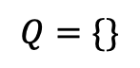

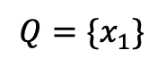
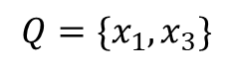


Max-min Distance Design
At each iteration of AL, we have following sets:
$D$: set of all data points
$L$: set of previously labeled data
$Q:$set of the previously queried points at the current iteration (not labeled yet)
The next point to be sampled for exploration is:
$$x^{∗}=\underset{x∈D\backslash \left\{L∪Q\right\}}{argmax}\{\min_{yεL∪Q}{\left\|x−y\right\|}_{2}\}$$
$$Q=\{\}$$
$$Q=\{x_{1}\}$$
$$Q=\{x_{1}, x_{3}\}$$
$$x_{4}$$
$$x_{4}$$
$$x_{4}$$
$$x_{3}$$
$$x_{3}$$
$$x_{3}$$
$$x_{1}$$
$$x_{1}$$
$$x_{1}$$
$$x_{2}$$
$$x_{2}$$
$$x_{2}$$

Slide 7
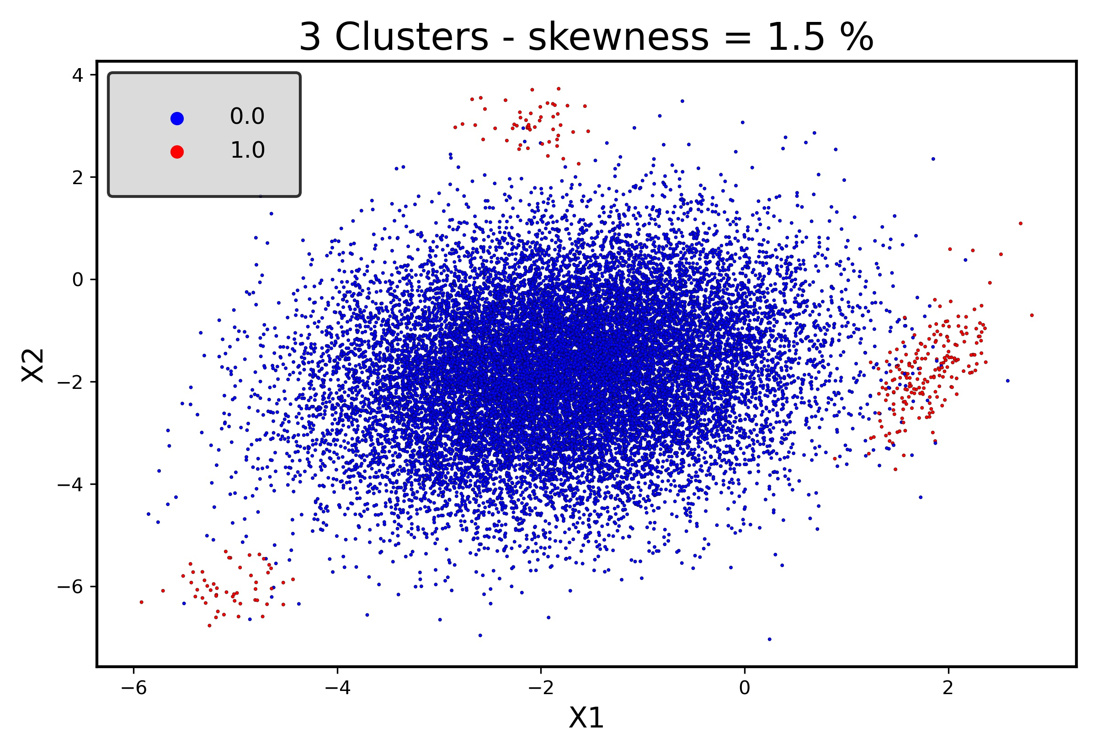
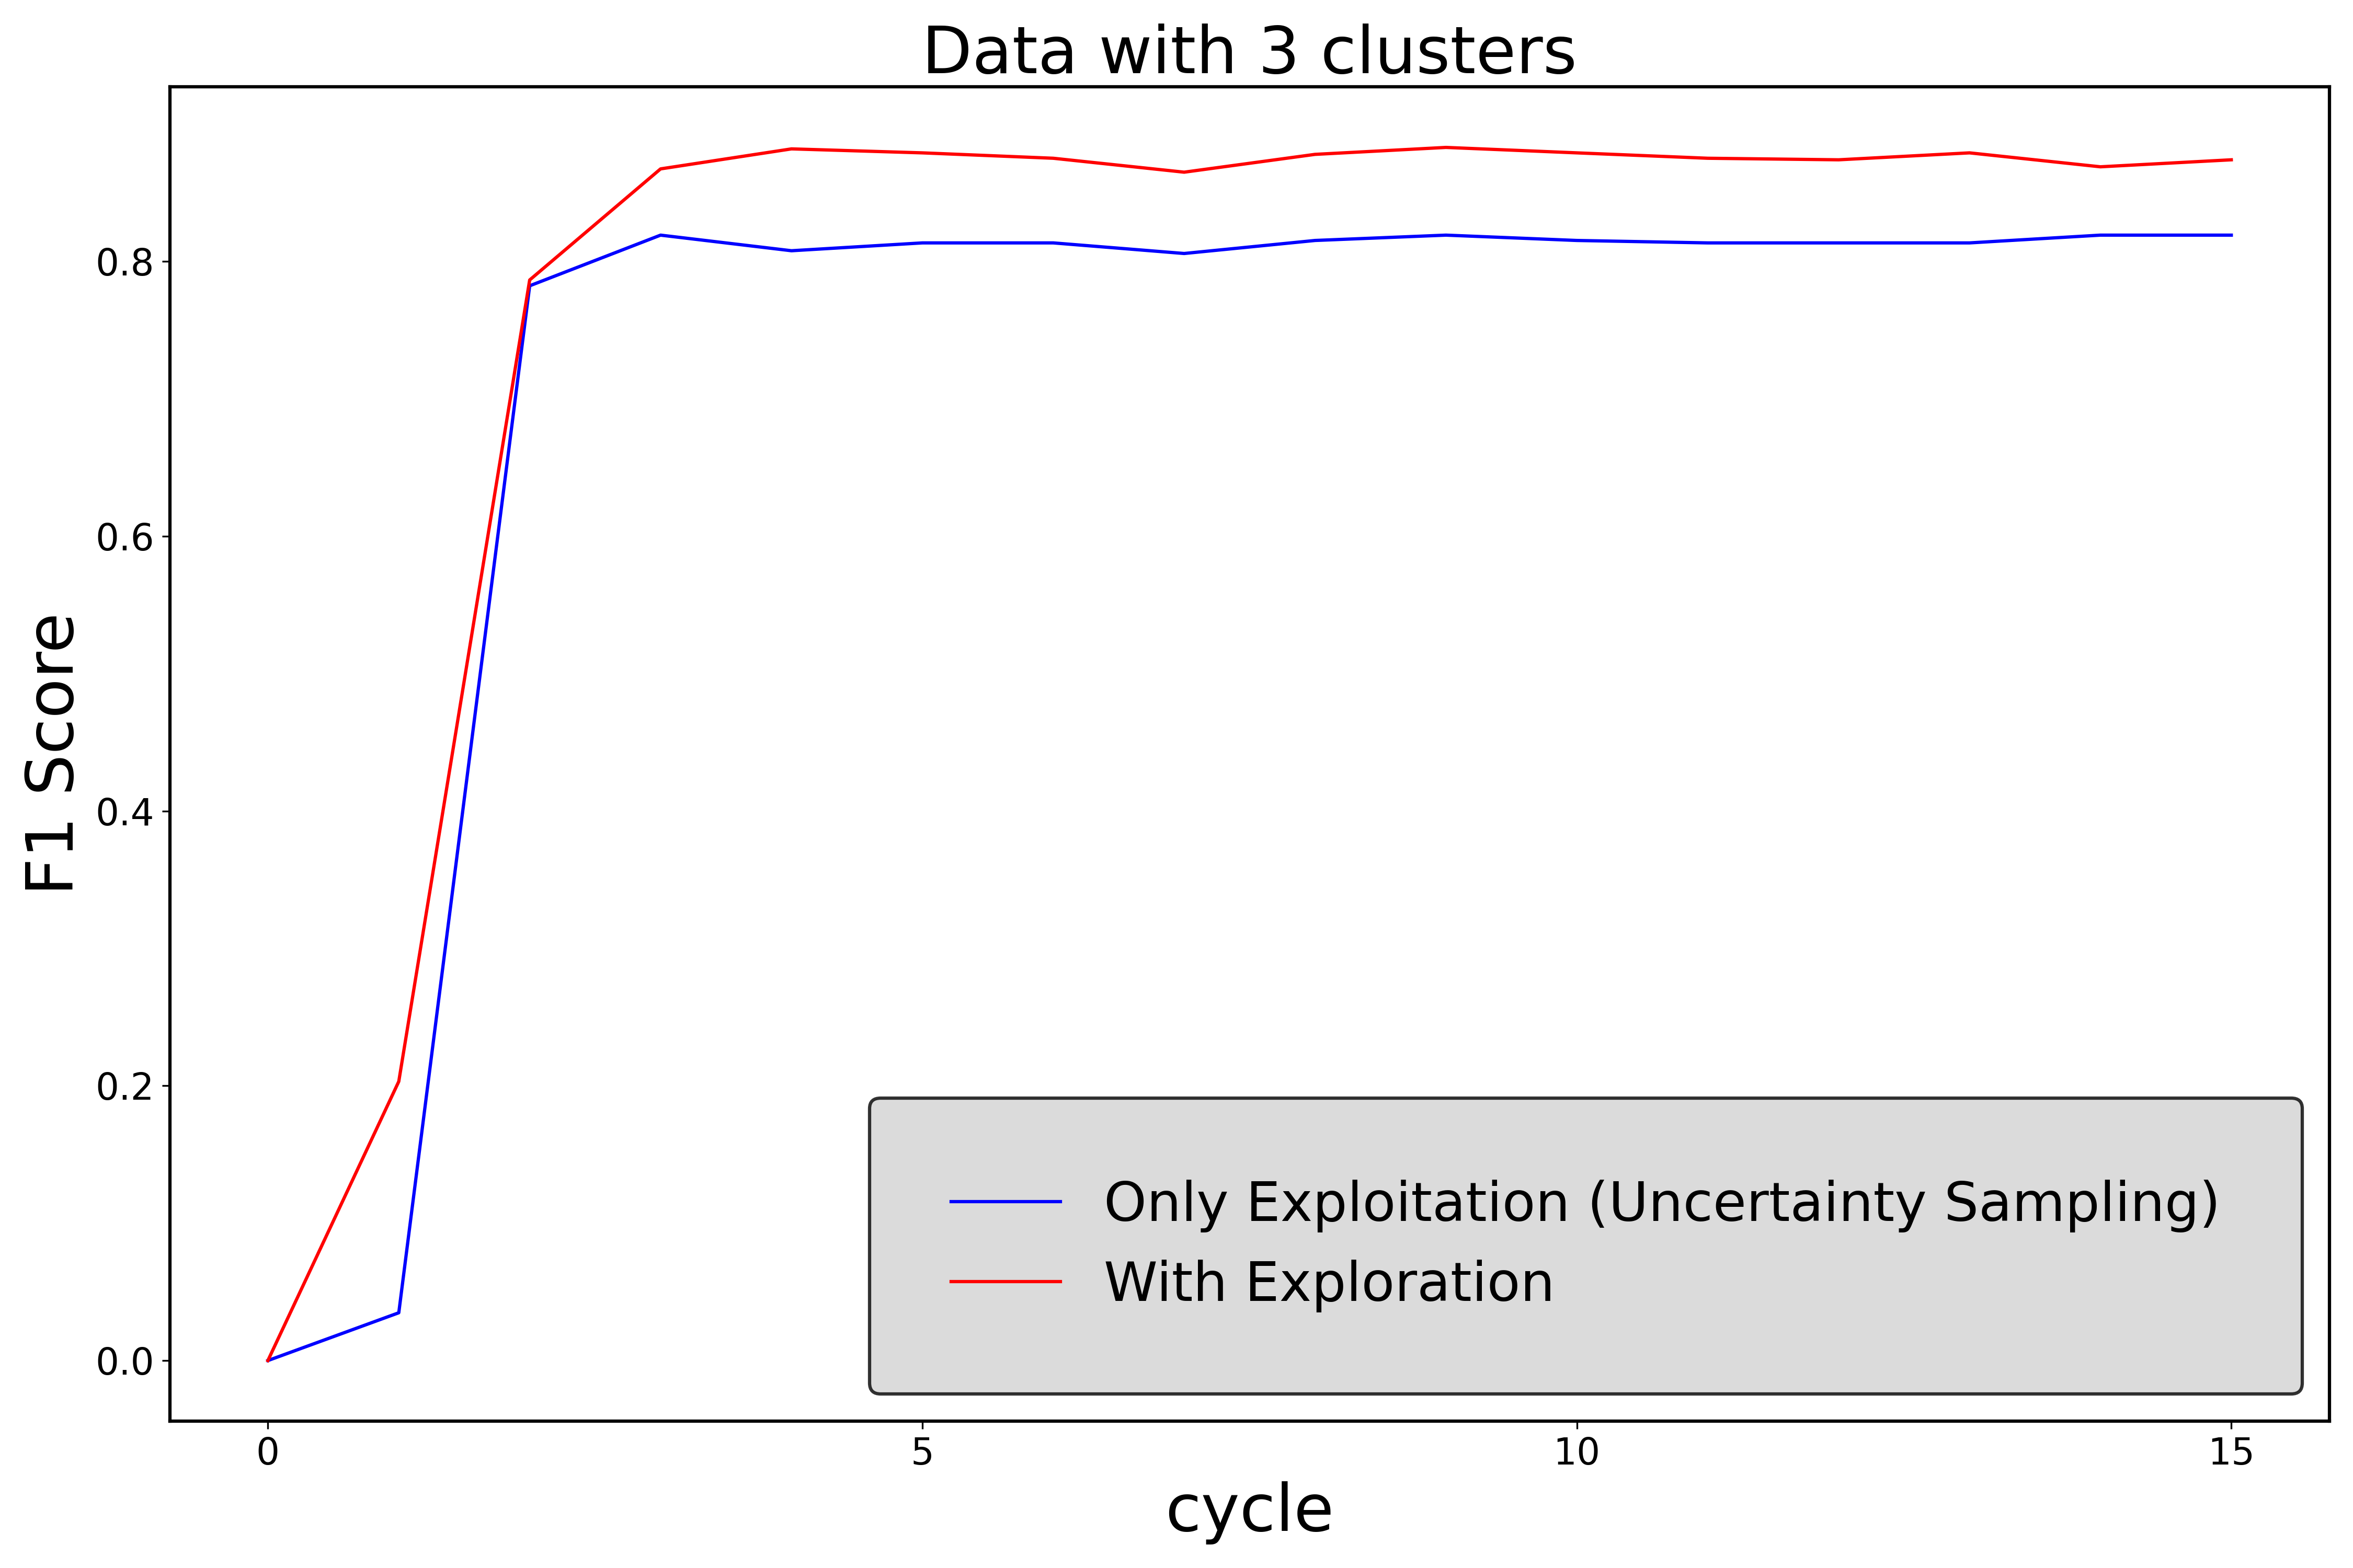
Experiments and Results
Class-wise accuracy
Budget: 100
Exploitation ratio: 0.9
 | Only Exploitation | With Exploration
Negative Class (blue) | 1.00 | 1.00
Positive Class (red) | 0.644 | 0.874

Slide 8
Thank you

